Slide 1

Precise Onset Cell Phone Vibration Detection
Technical Deep Dive Presentation
National Center for Adaptive Neurotechnologies (NCAN)
Muhammed Shuaib, Md. Sadman Kabir, Daniel Brown, Nasser AL-Maskari
Date: 12/01/23

Slide 2

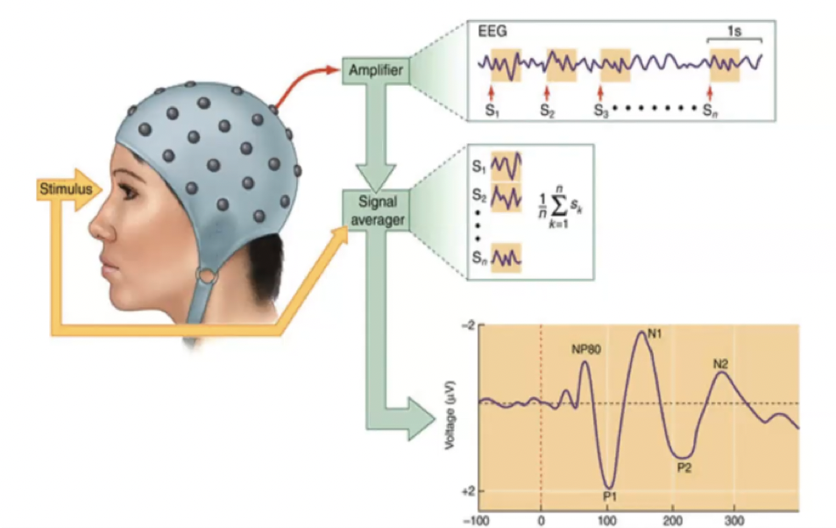
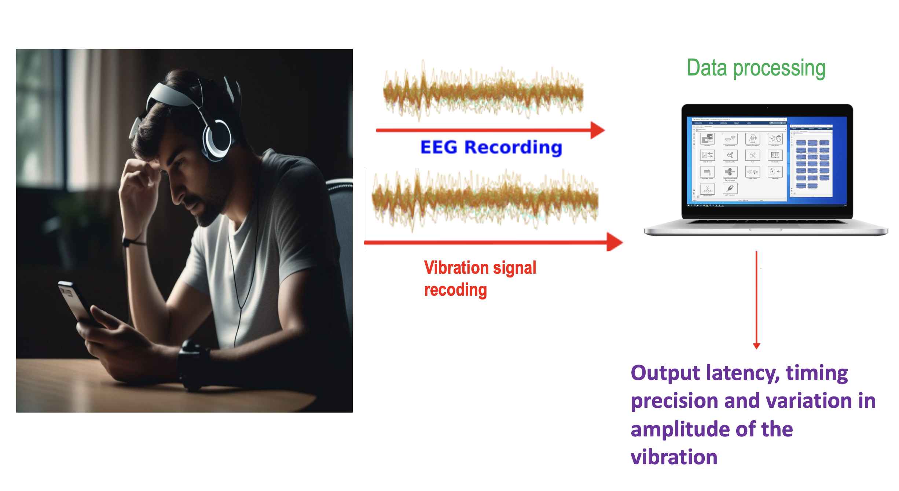
Introduction
Brain and spinal cord injury lead to somatosensory impairments such as loss of sense of touch, there are limited methods available to improve and test during the rehabilitation of these impairments.
There is a need for a portable device for precise detection of stimulus onset on a large group.

Slide 3
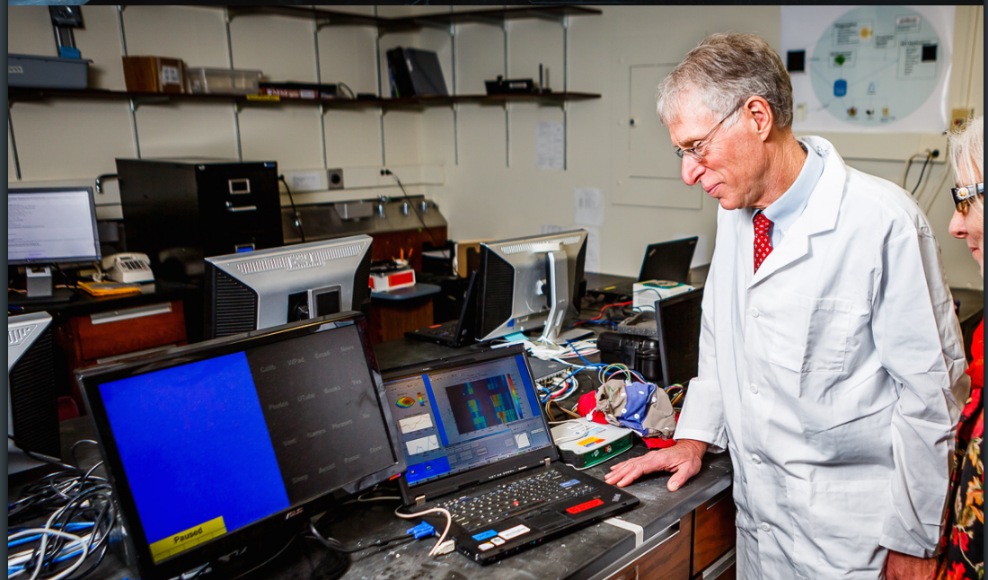
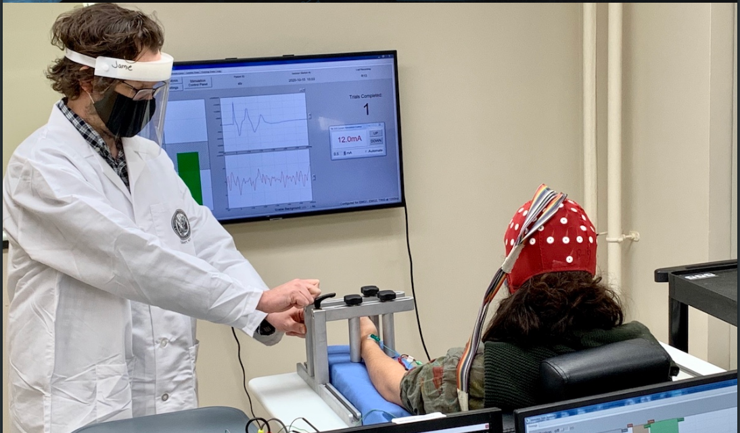
Background and Context
NCAN's senior scientists, Dr. Hill and Dr. Gupta, require us to build a high-precision, low-latency, affordable device for detecting Vibration Onset with 5ms accuracy
Image Source: NCAN website
(https://www.neurotechcenter.org/)

Slide 4
Agenda
Problem Statement & Requirements
Design Methodology
Physical Design & Logical Design
System Demonstration
Experiment Design
Experiment Results
Data & Analysis

Slide 5
Problem Statement
To build a System That Detects Cell Phone Vibration within a 5ms Latency Using Hardware
Software Solutions are unreliable.

Slide 6
Key System Requirements
Detector must be easy to hold.
Functional Requirements
Vibration Detection
Non-functional Requirements.
Under 100$
Hardware Based
Require NO alterations to the phone
TTL output: The System must output a TTL high Signal
Latency of less than 5ms
Our System Requirements were chosen to ensure a balance between performance, Budget, and Usability.

Slide 7
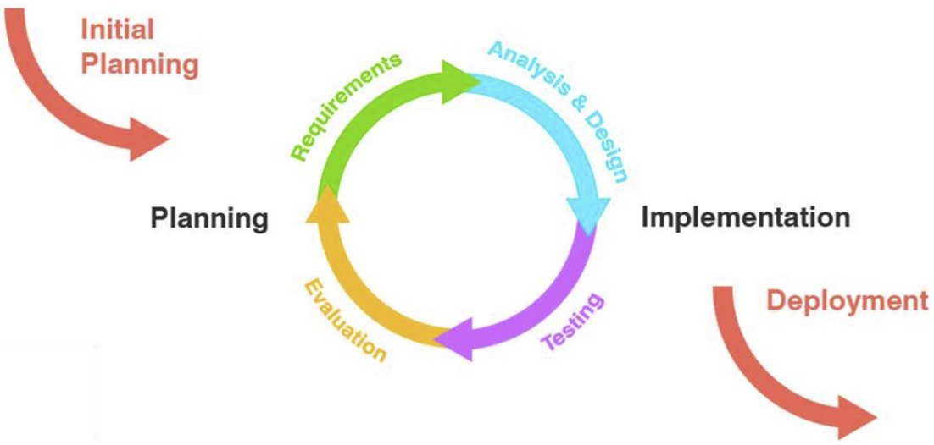
Methodology
We used an iterative process. We are currently on the third loop.
Tested a Piezo sensor, an Accelerometer, and a Microphone
After evaluation, we chose to use a Piezo Sensor.
We used BCI2000, a software library developed by Dr. Hill for real time signal viewing and used Matlab for signal processing to find our final experimental results.

Slide 8
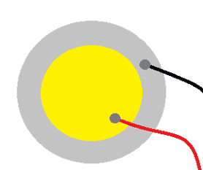
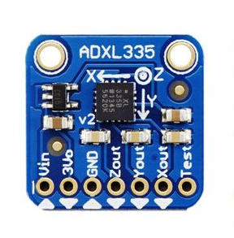
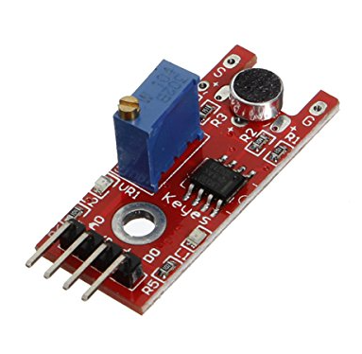
Decision matrix PIEZO vs Accelerometer vs Microphone
Criteria | Piezo | Accelerometer | Microphone
Accuracy | Excellent | Good | Poor
Sensitivity | Excellent | Excellent | Poor
cost | Excellent | Good | Excellent
Durability | Good | Excellent | Good
Size | Good | Good | Good

Slide 9
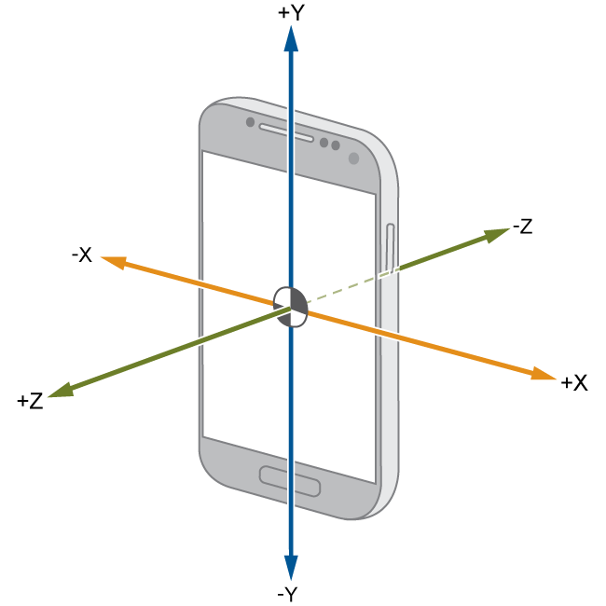
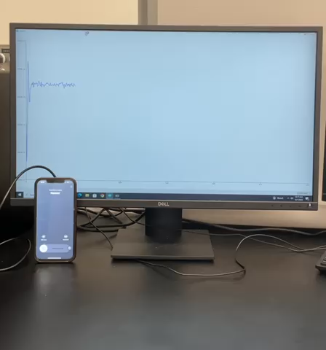
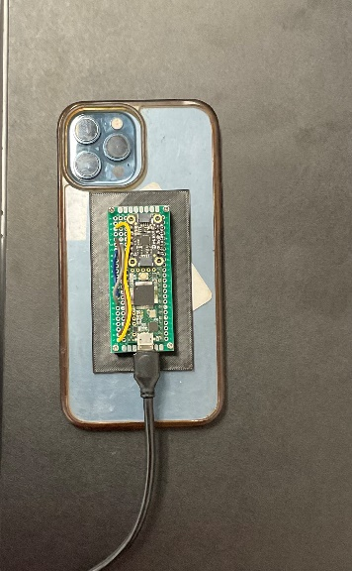
Accelerometer
Accelerometers are positioned to detect motion and vibrations along different axes (typically x, y, and z). It measures the acceleration of forces

Slide 10
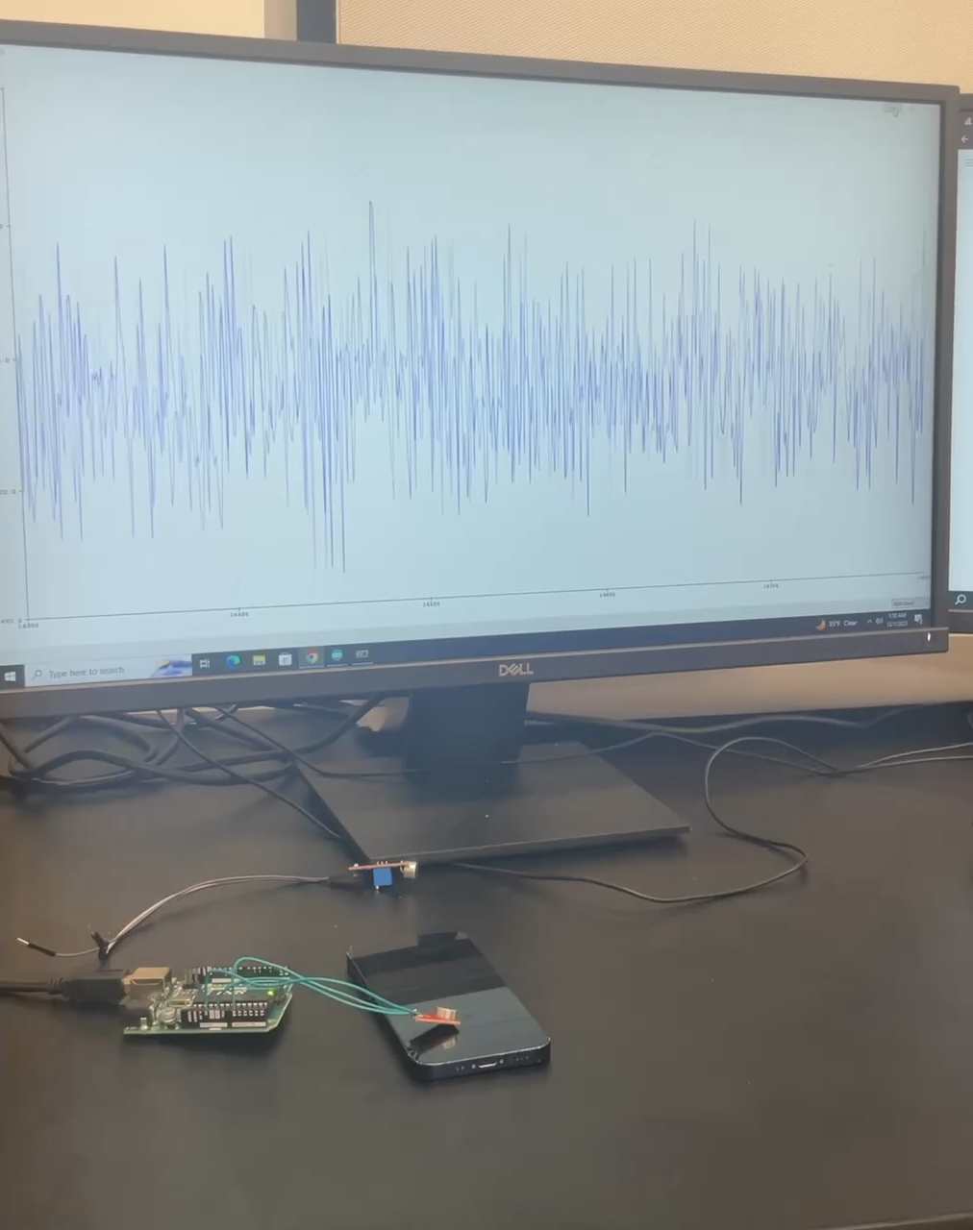
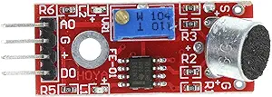
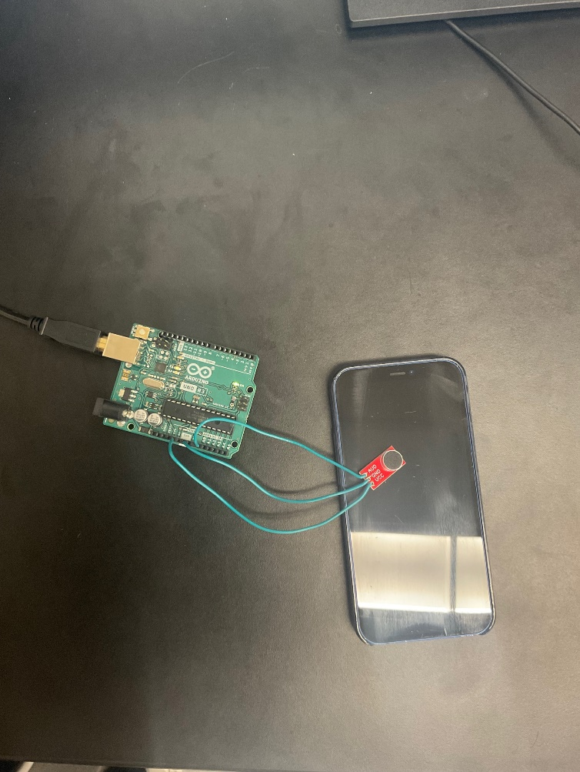
Microphone

Slide 11
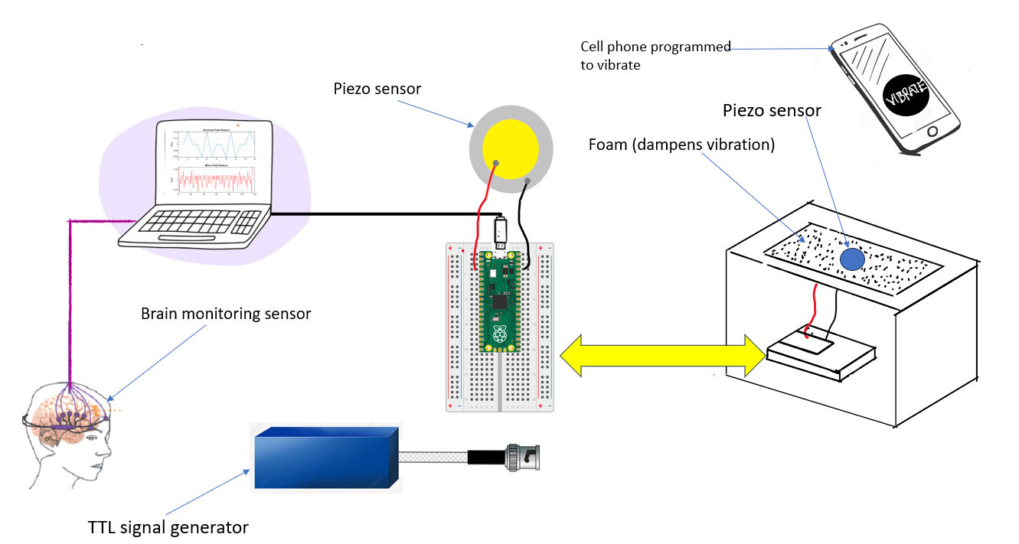
Logical Design

Slide 12
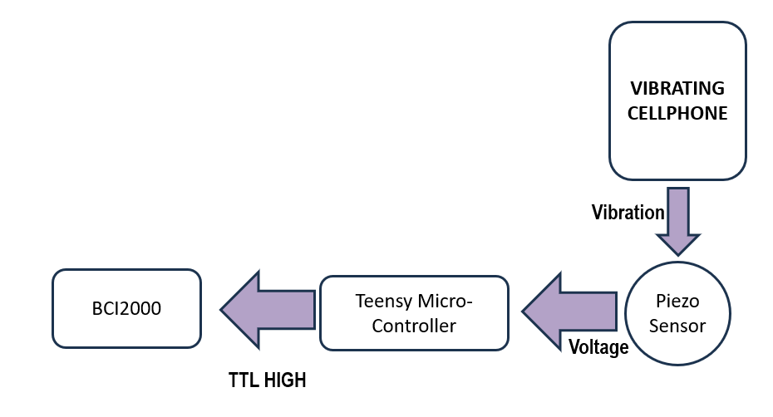
VIBRATING CELLPHONE
Vibration
BCI2000
Piezo Sensor
Teensy Micro-Controller
Voltage
TTL HIGH

Slide 13
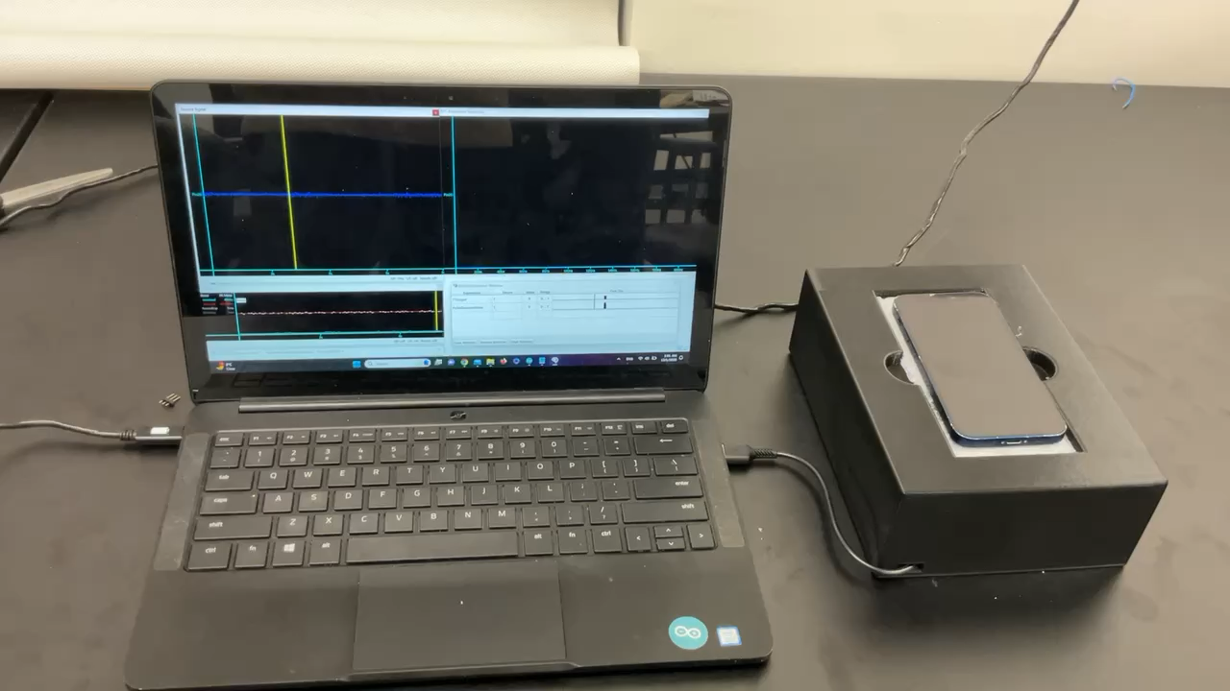
System demo

Slide 14
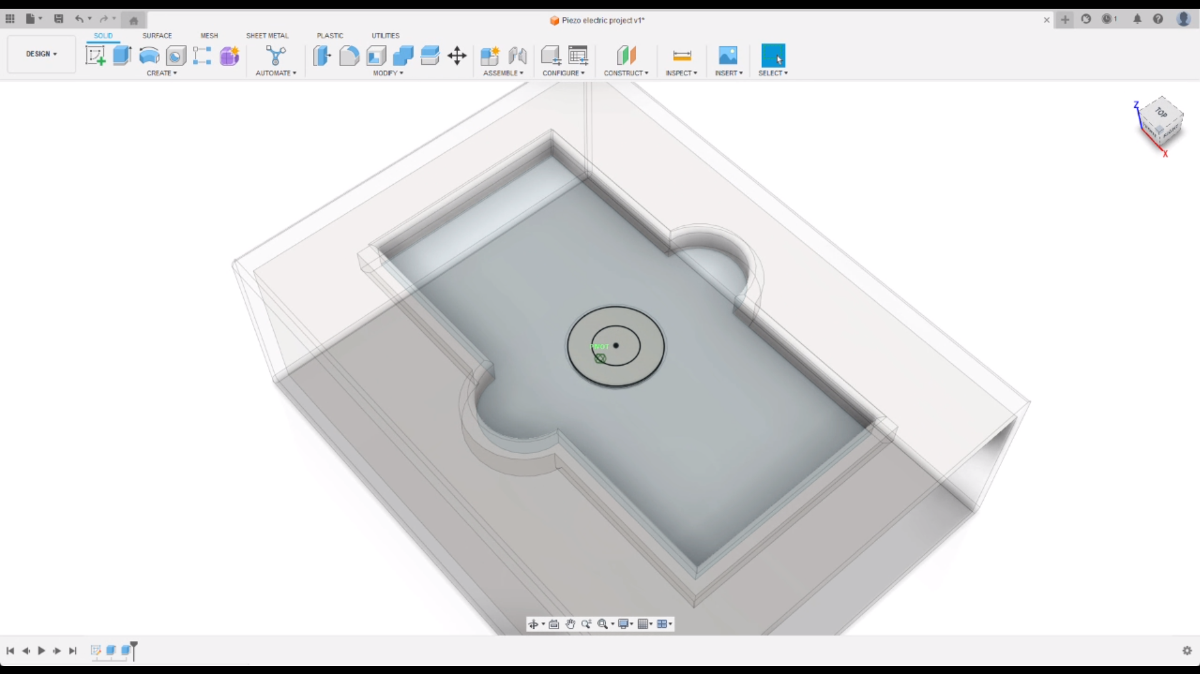
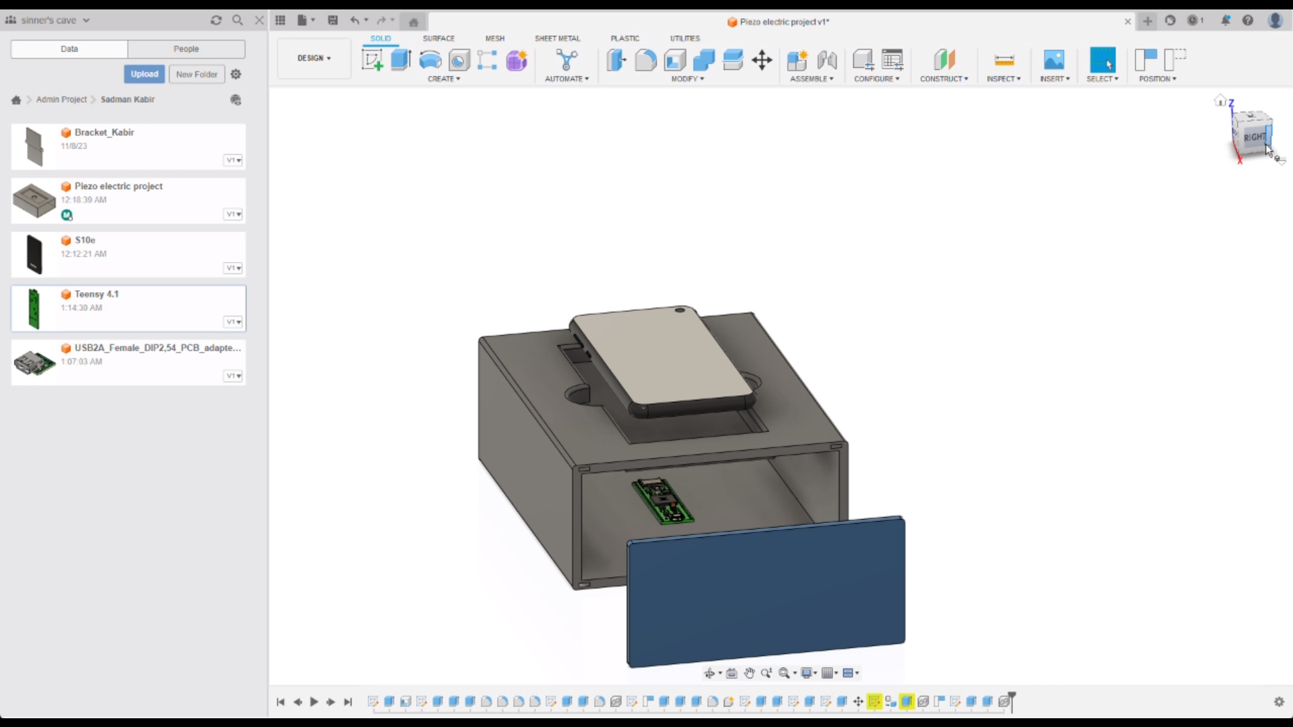
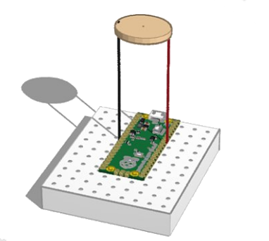
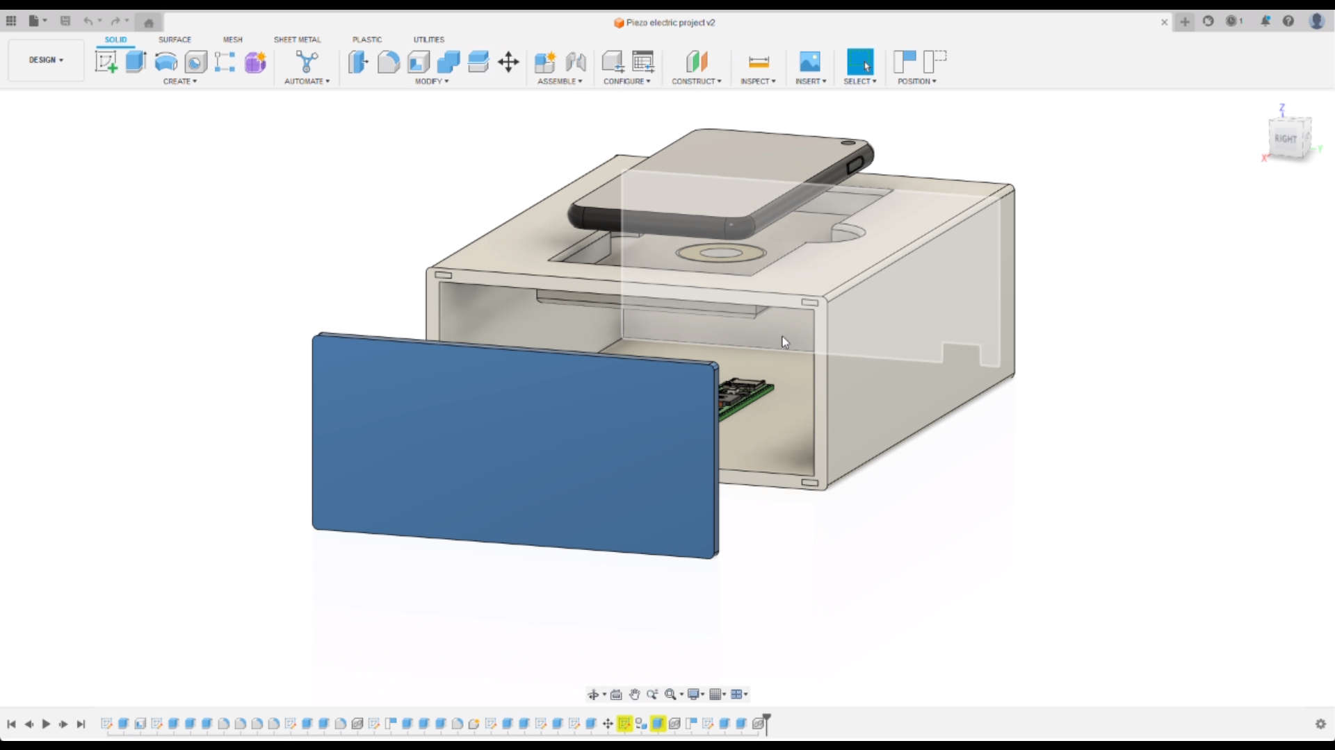
Physical Design

Slide 15
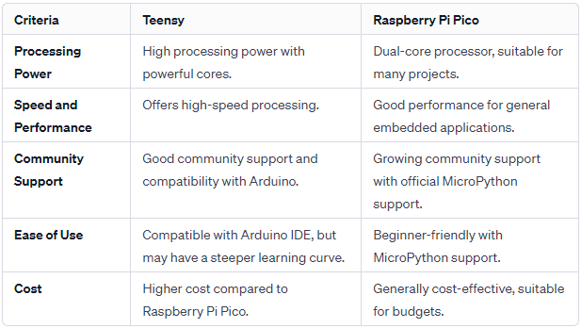
Decision matrix: Teensy vs Raspberry Pi Pico
We chose Teensy for our project because we require high-speed processing and extensive capabilities. And, based on our experiment results with the Piezo in different orientations with the both of them, Teensy is a far better option for us.

Slide 16
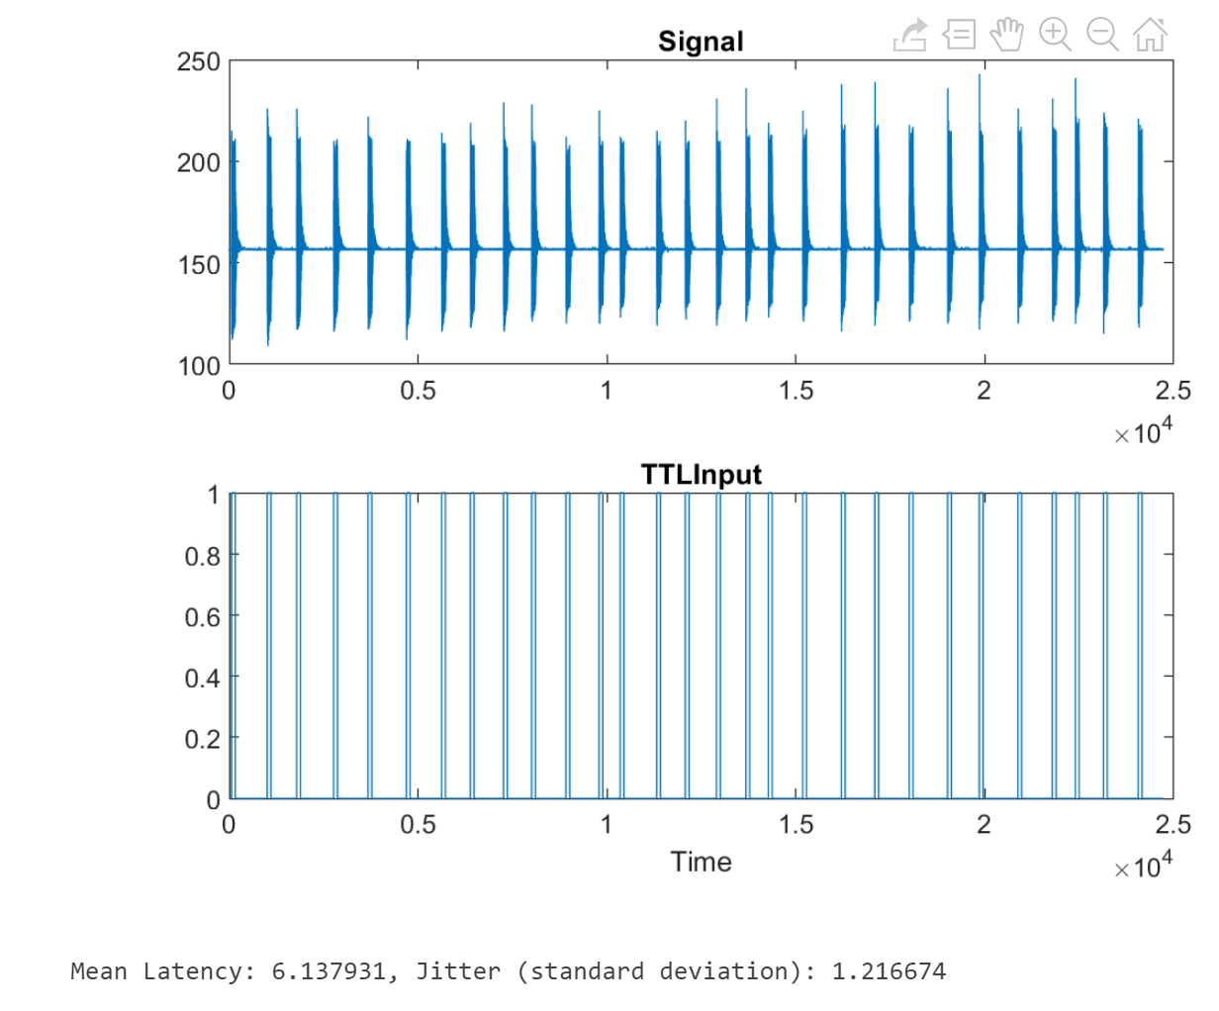
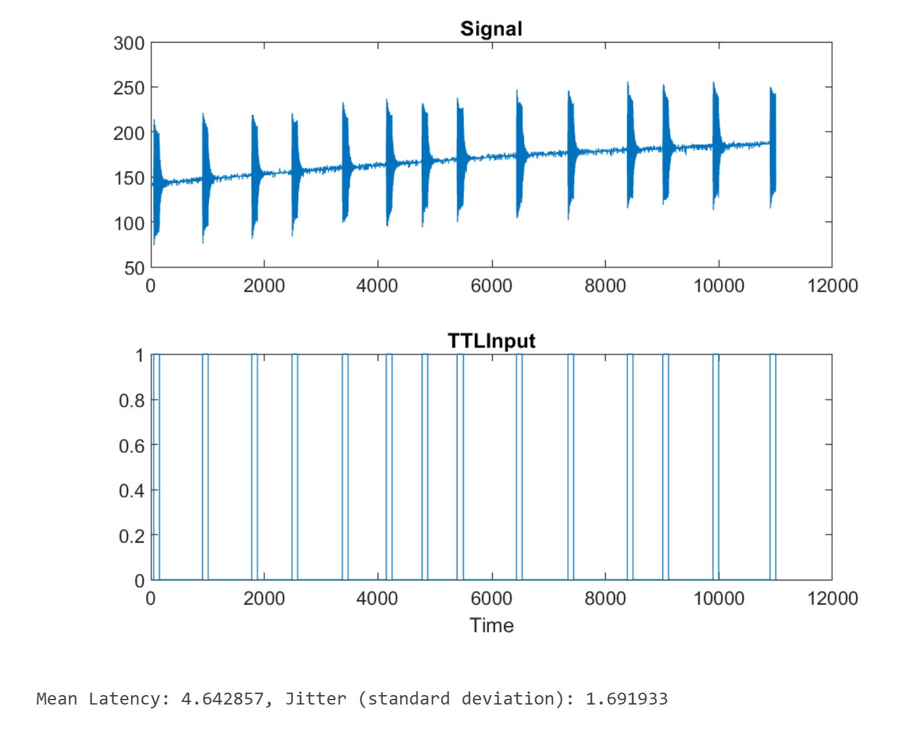
Data and Results
sensor down
sensor taped
Latency: 6.138 Jitter: 1.2166
Latency: 4.648 Jitter: 1.6919

Slide 17
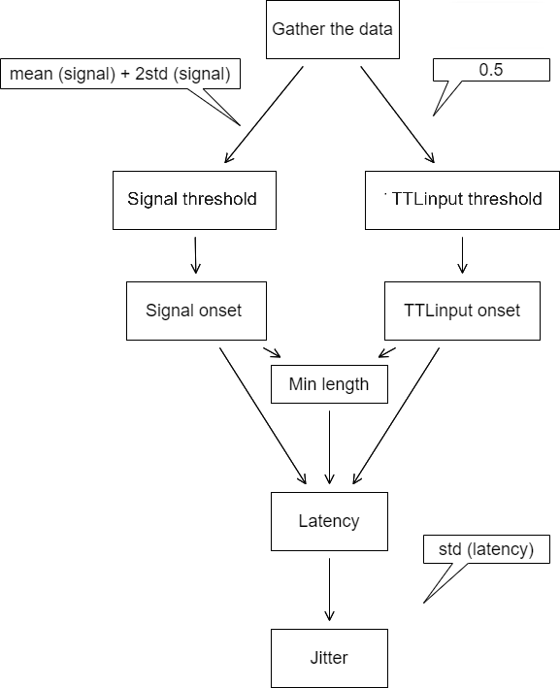
Flow Chart of MATLAB Functions

Slide 18
Project Limitations
Research Vacuum
Lack of pre-established frameworks and detailed project specifications necessitated extensive research. Initial project progress was delayed as the team invested significant time understanding the problem domain, relevant technologies, potential solutions and experimentation.
Time Crunch
Strict deadlines necessitated a rapid pace for research, development, and implementation. Due to that we had limited time for in-depth exploration, potentially compromising the thoroughness of research and the depth of project outcomes.

Slide 19
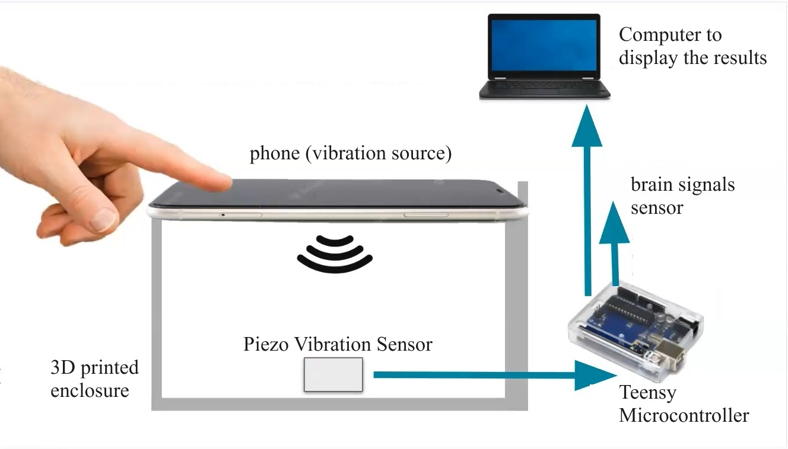
Recommendations for Future Work
Research how Finger pressure can dampen the signal given by the piezo.

Slide 20
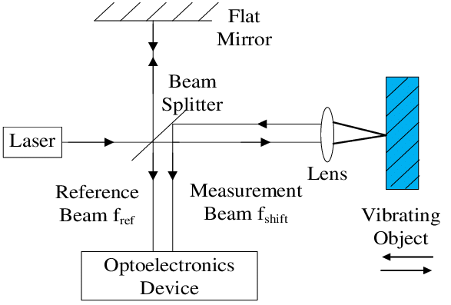
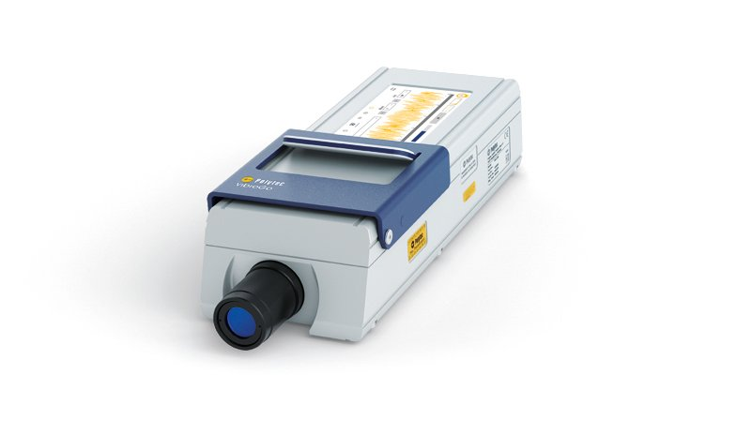
Recommendations for Future Work
Transition to a contactless solution using Laser Doppler Detection

Slide 21
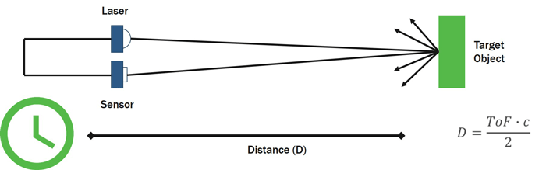
Recommendations for Future Work
Transitioning to a contactless solution using RADAR
Implement current System with RADAR replacing Piezo

Slide 22
Conclusions
Piezo detection: 1.6ms Jitter, 4.6ms Latency
Goal: <5ms Latency.
As defined earlier, a sub 5ms Latency is considered Instantaneous to the human perception.
We have Shown that the Piezo can be considered both Precise and Accurate.
We have Printed and mounted the Box unto the cell phone and Piezo Sensor.

Slide 23
Individual Contributions
Muhammed Shuaib
Support Roles: Point of contact, Scheduler
Most Significant Contributions: Designing logical design diagram, Accelerometer research and implementation. Experimentation.
Md. Sadman Kabir
Support Roles: Editor
Most Significant Contributions: 3D Design of the prototype and printing, Research, Teensy experiments with the Piezo.
Daniel Brown
Support Roles: Archivist
Most Significant Contributions: Piezo and future implementation research. Raspberry Pi Pico experiments with the Piezo.
Nasser AL-Maskari
Support Roles: Treasurer
Most Significant Contributions: Data and result implementation, MATLAB signal acquisition, Experimentation.

Slide 24
Questions

